Slide 1

Application Layer: FTP, P2P and CDN
Lecture 5 | CSE421 – Computer Networks
Department of Computer Science and Engineering School of Data & Science

Slide 2
Objectives
File Distribution
FTP
Client-Server Architecture
P2P Architecture
CDN

Slide 3
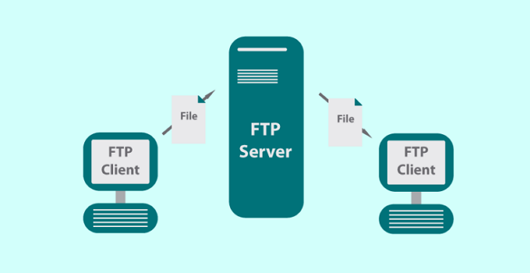
FTP

Slide 4
FTP
FTP stands for File transfer protocol.
FTP is a standard internet protocol provided by TCP/IP used for transmitting the files from one host to another.
It is mainly used for transferring the web page files from their creator to the computer that acts as a server for other computers on the internet.
It is also used for downloading the files to computer from other servers.
Objectives:
It provides the sharing of files.
It is used to encourage the use of remote computers.
It transfers the data more reliably and efficiently

Slide 5
Why FTP?
Two systems may have different:
file conventions.
ways to represent text and data.
directory structures.
FTP protocol overcomes these problems by establishing two connections between hosts. One connection is used for data transfer, and another connection is used for the control connection.

Slide 6
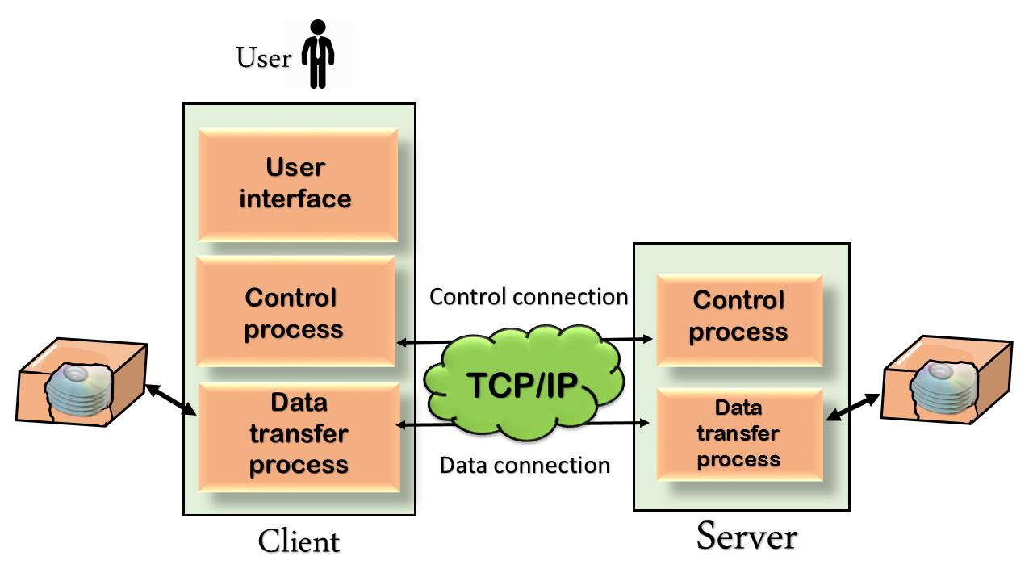
Mechanism of FTP
Types of connections:
Control Connection
Data Connection
Components:
The User Interface
Control Process
Data Transfer Process

Slide 7
Types of FTP Connections
Control Connection: The control connection uses very simple rules for communication. Through control connection, we can transfer a line of command or line of response at a time. The control connection is made between the control processes. The control connection remains connected during the entire interactive FTP session.
Data Connection: The Data Connection uses very complex rules as data types may vary. The data connection is made between data transfer processes. The data connection opens when a command comes for transferring the files and closes when the file is transferred.

Slide 8
FTP Clients
FTP client is a program that implements a file transfer protocol which allows you to transfer files between two hosts on the internet.
It allows a user to connect to a remote host and upload or download the files.
It has a set of commands that we can use to connect to a host, transfer the files between you and your host and close the connection.

Slide 9
FTP Ups and Downs
Advantages
Speed: The FTP is one of the fastest way to transfer the files from one computer to another computer.
Efficient: It is more efficient as we do not need to complete all the operations to get the entire file.
Security: To access the FTP server, we need to login with the username and password.
Back & forth movement: Suppose you are a manager of the company, you send some information to all the employees, and they all send information back on the same server.
Disadvantages
The standard requirement of the industry is that all the FTP transmissions should be encrypted. However, not all the FTP providers are equal and not all the providers offer encryption.
FTP has the size limit of the file is 2GB that can be sent. It also doesn't allow you to run simultaneous transfers to multiple receivers.
Passwords and file contents are sent in clear text that allows unwanted eavesdropping.
It is not compatible with every system.

Slide 10
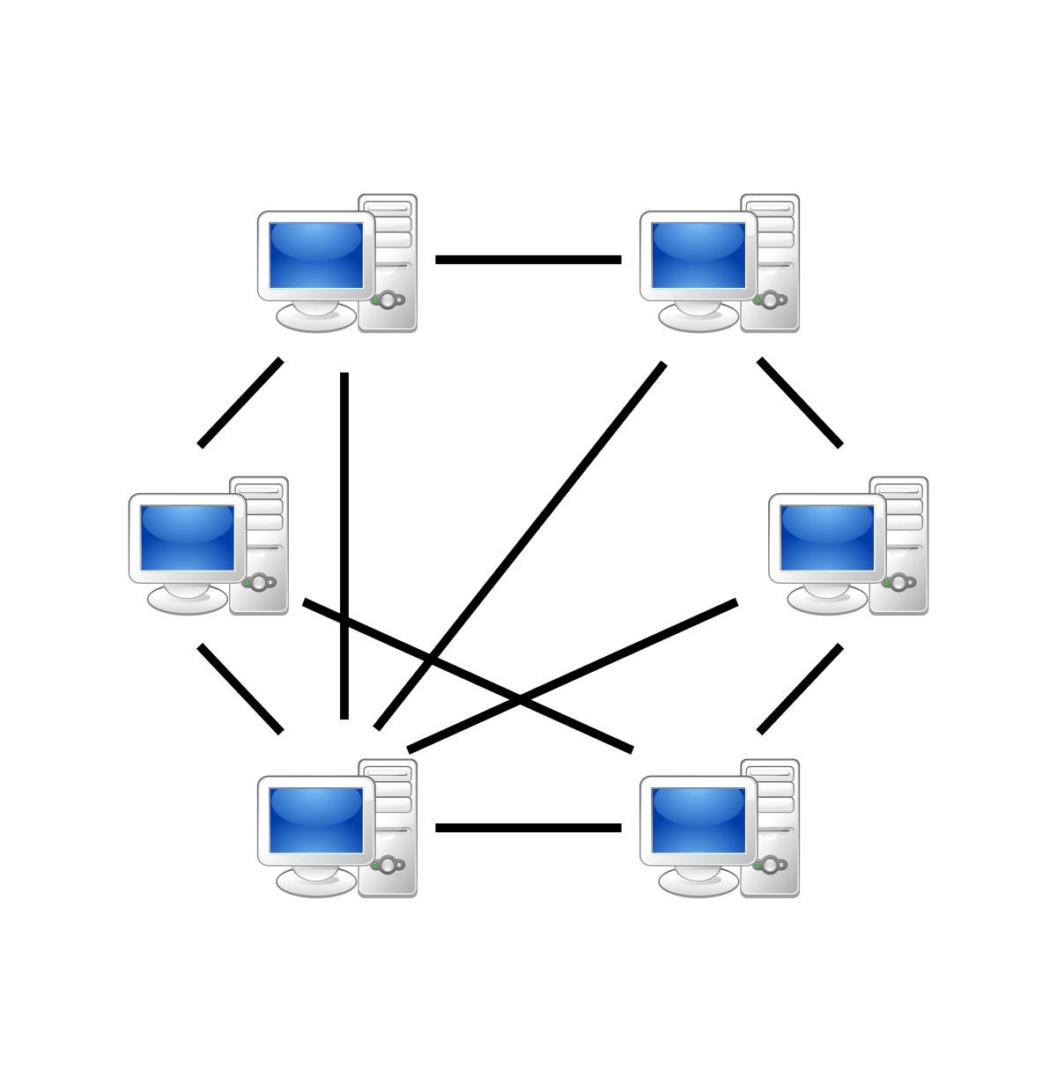
P2P Applications

Slide 11

















Pure P2P Architecture
No always-on server
Arbitrary end systems directly communicate
Peers are intermittently connected and change IP addresses
Files are shared in chunks rather than a whole single file
A successful file transfer is possible if all clients collectively have all the chunks of a file
Examples:
File distribution (BitTorrent)
Streaming (KanKan)
VoIP (Skype)

Slide 12

File Distribution
How much time is required to distribute a file (of size F) from one server to ‘N’ number of peers?
Peer (client) upload/download capacity is limited resource
u_{s}: server upload capacity
u₁
d_{i}: peer i download capacity
file (size F)
u_{s}
d₁
u₂
d₂
server
d_{i}
u_{N}
network (with abundant
bandwidth)
u_{i}
d_{N}
u_{i}: peer i upload capacity

Slide 13
Terms of equations
Given:
File size = f
Number of clients = n
Server upload speed = u_{s}
Download speed of peer ‘i’ = d_{i}
Upload speed of peer ‘i’ = u_{i}
Time to distribute files using client-server approach = T_{c-s}
Time to distribute files using peer-to-peer approach = T_{P2P}
The peer with the slowest download speed = d_{min}
Summation of upload speed of all peers = Σu_{i}

Slide 14
File Distribution: Client-Server
Server:
Time to send one copy of file from the server = f/u_{s}
Hence, time to send this one file to n number of clients = n * f/u_{s} = nf/u_{s}
Client:
Downloading time of the slowest client = f/d_{min}
Time to distribute file ‘f’ to ‘n’ clients using client-server approach
T_{c-s} ≥ max {nf/u_{s}, f/d_{min}}
So, why the max value of the above two?
It’s because, if the server needs 10minutes to upload a file, a client can never download it before 10 minutes.
If the slowest client needs 15 minutes to download the file, even though server needs 10 minutes to upload, there’s no point. The transfer won’t finish before 15 minutes.
Lastly, T_{c-s} will take a equal or greater value because, this is the minimum time possible (does not consider any delays). In real world, speed is always not at its maximum, speed varies.

Slide 15
File Distribution: P2P
Server transmission: must upload at least one copy
Time to upload file f from the server = f/u_{s}
Downloading time of the slowest client = f/d_{min}
Total downloaded file size by n clients = n * f = nf
The more clients participate in the file sharing.. the more upload speed
Total upload speed of n clients = u₁ + u₂ + u₃ + …. + u_{n} = Σu_{n}
Max upload rate (limiting max download rate) = u_{s} + Σu_{n}
Time to download the files n times by using the upload speed of all clients = nf/(u_{s} + Σu_{n})
Time to distribute file ‘f’ to ‘n’ clients using peer-to-peer approach
T_{c-s} ≥ max {f/u_{s}, f/d_{min}, nf/(u_{s} + Σu_{n})}

Slide 16
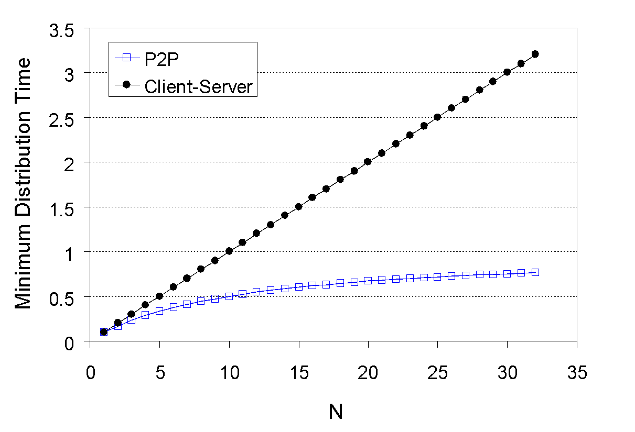
Client-Server vs P2P

Slide 17


P2P File Distribution: BitTorrent
File divided into 256Kb (it can be any size!) chunks
Peers in torrent send/receive file chunks
tracker: tracks peers
participating in torrent
torrent: group of peers exchanging chunks of a file
Alice arrives …
… obtains list
of peers from tracker
… and begins exchanging
file chunks with peers in torrent

Slide 18


P2P File Distribution: BitTorrent
A new peer joining torrent:
has no chunks, but will accumulate them over time from other peers
registers with tracker to get list of peers and connects to a subset of peers (“neighbors”) found on the tracker list.
While downloading, a peer also uploads chunks to other peers
A peer may change its connected peers with whom it exchanges chunks
Churn: connected peers may come and go
Once a peer has the entire file, it may (selfishly; a leacher) leave or (altruistically; a seeder) remain in the torrent (sharing its chunks with others)

Slide 19

P2P File Distribution: BitTorrent
(1) Alice “optimistically unchokes” Bob
(2) Alice becomes one of Bob’s top-four providers; Bob reciprocates
(3) Bob becomes one of Alice’s top-four providers
higher upload rate: find better trading partners, get file faster !

Slide 20
P2P Example
Say, a torrent has 100 pieces/chunks.
Example 1:
Client 1 has chunks 1 to 30 – Peer
Client 2 has chunks 25 to 60 – Peer
Client 3 has chunks 1 to 100 – Seeder
Client 4 joins the torrent… Will this client be able to download the whole torrent?
Example 2:
Client 1 has chunks 1 to 30 – Peer
Client 2 has chunks 25 to 60 – Peer
Client 3 has chunks 60 to 99 – Seeder
Client 4 joins the torrent… Will this client be able to download the whole torrent?

Slide 21
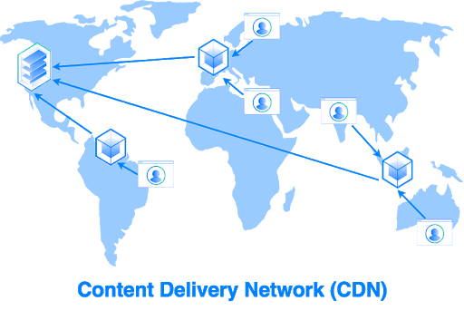
Content Distribution Networks (CDN)

Slide 22





Video Streaming and CDNs: Context
Video traffic: major consumer of Internet bandwidth
Netflix, YouTube: 37%, 16% of downstream residential ISP traffic
~1B YouTube users, ~75M Netflix users
Challenges:
Scale: how to reach ~1B users? single mega-video server won’t work (why?)
Heterogeneity: different users have different capabilities (e.g., wired versus mobile; bandwidth rich versus bandwidth poor)
Solution: distributed, application-level infrastructure

Slide 23

Multimedia Video
spatial coding example: instead of sending N values of same color (all purple), send only two values: color value (purple) and number of repeated values (N)
Video: sequence of images displayed at constant rate
e.g., 24 images/sec
Digital image: array of pixels
each pixel represented by bits
Coding: use redundancy within and between images to decrease number of bits used to encode image
spatial (within image)
temporal (from one image to next)
……………………..
……………….…….
frame i
temporal coding example: instead of sending complete frame at i+1, send only differences from frame i
frame i+1

Slide 24
Multimedia: Video
CBR (constant bit rate): video encoding rate fixed
VBR (variable bit rate): video encoding rate changes as amount of spatial, temporal coding changes
Examples:
MPEG 1 (CD-ROM) 1.5 Mbps
MPEG2 (DVD) 3-6 Mbps
MPEG4 (often used in Internet, < 1 Mbps)

Slide 25


Streaming Stored Video
Simple scenario
Internet
video server
(stored video)
client

Slide 26
Streaming: DASH
DASH: Dynamic, Adaptive Streaming over HTTP
Server:
divides video file into multiple chunks
each chunk stored, encoded at different rates
manifest file: provides URLs for different chunks
Client:
periodically measures server-to-client bandwidth
consulting manifest, requests one chunk at a time
chooses maximum coding rate sustainable given current bandwidth
can choose different coding rates at different points in time (depending on available bandwidth at time)

Slide 27
Streaming: DASH
“Intelligence” at client: client determines
when to request chunk (so that buffer starvation, or overflow does not occur)
what encoding rate to request (higher quality when more bandwidth available)
where to request chunk (can request from URL server that is “close” to client or has high available bandwidth)

Slide 28
Content Distribution Networks (CDNs)
Challenge: how to stream content (selected from millions of videos) to hundreds of thousands of simultaneous users?
Option 1: single and large “mega-server”
Single point of failure
Long path to distant clients
Multiple copies of video sent over outgoing link
Option 2: store multiple copies of videos at multiple distributed sites (CDN)
Enter Deep: push CDN servers deep into many access networks
close to users
used by Akamai, 1700 locations
Bring Home: smaller number (10’s) of larger clusters in POPs near (but not within) access networks
used by Limelight
Single point of network congestion
This solution doesn’t scale

Slide 29




Content Distribution Networks (CDNs)
CDN: stores copies of content at CDN nodes
e.g. Netflix stores copies of MadMen
subscriber requests content from CDN
directed to nearby copy, retrieves content
may choose different copy if network path congested
…
…
…
manifest file
…
where’s Madmen?
…
…

Slide 30
Content Distribution Networks (CDNs)
Over the top challenges: coping with a congested Internet
From which CDN node to retrieve content for a user?
What’s the viewer behavior in presence of a congestion?
What content to place in which CDN node?

Slide 31
CDN Content Access: A Closer Look
Bob (client) requests video http://netcinema.com/6Y7B23V
video stored in CDN at http://KingCDN.com/NetC6y&B23V
1. Bob gets URL for video http://netcinema.com/6Y7B23V
from netcinema.com web page
2. resolve http://netcinema.com/6Y7B23V
via Bob’s local DNS
1
2
6. request video from
KINGCDN server,
streamed via HTTP
5
Bob’s
local DNS
server
netcinema.com
3. netcinema’s DNS returns URL
http://KingCDN.com/NetC6y&B23V
4&5. Resolve
http://KingCDN.com/NetC6y&B23
via KingCDN’s authoritative DNS,
which returns IP address of KingCDN
server with video
4
3
netcinema’s
authoratative DNS
KingCDN.com
KingCDN
authoritative DNS

Slide 32
Case Study: Netflix
Amazon cloud
upload copies of multiple versions of video to CDN servers
CDN
server
Netflix registration,
accounting servers
3. Manifest file
returned for
requested video
2. Bob browses
Netflix video
CDN
server
2
3
1
1. Bob manages Netflix account
CDN
server
4. DASH streaming

Slide 33
The End
References
[1] Brownlee, M. [MKBHD]. (2019, October 12). This Is What Happens When You Re-Upload a YouTube Video 1000 Times! . Retrieved from https://www.youtube.com/watch?v=JR4KHfqw-oE
[2] Kurose, J. F., & Ross, K. W. (2017). Computer networking: A top-down approach.

